Slide 1

ILP 2022 – W3S2-3 The list type
Matthieu DE MARI – Singapore University of Technology and Design

Slide 2
Outline (Week3, Session2-3 – W3S2-3)
The list type (in detail)
Length of a list
Indexing, slicing, updating and traversing a list
Lists of lists
Membership
Concatenation, repetition and insertion
Removing elements from a list
Advanced methods and RTFM!

Slide 3
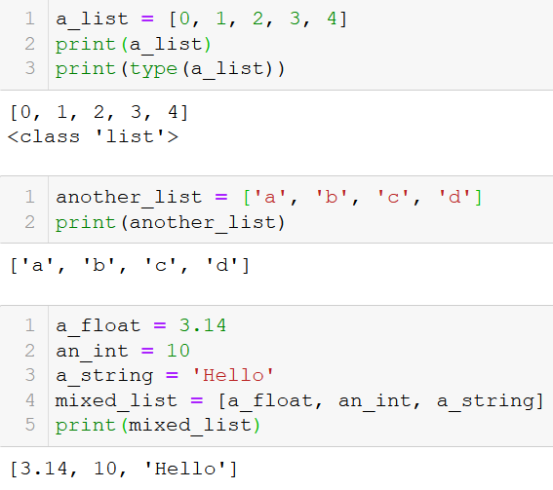
The list type
Let us first discuss a new type of objects, called lists.
Definition (lists): a list is a sequence of several variable elements, listed in order, between brackets and separated by commas.
It can contain variables of any types (int, float, string, etc.).
List can also contain mixed types of variables.

Slide 4
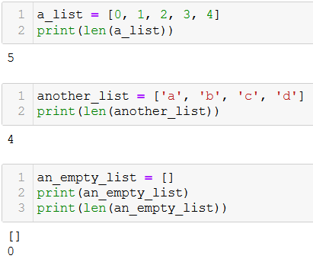
Length of a list
Definition (length of a list): The length of a list consists of the number of elements in the list.
It can be simply computed with the len() function, which returns a positive integer corresponding to the number of elements in the list.

Slide 5
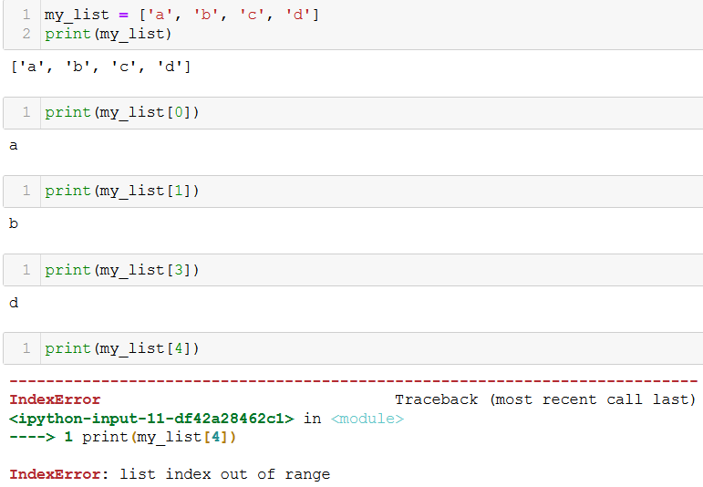
Indexing/Accessing the elements of a list
The elements in a list are indexed, with integers.
They can be accessed using the [] notation, with an index value.

Slide 6
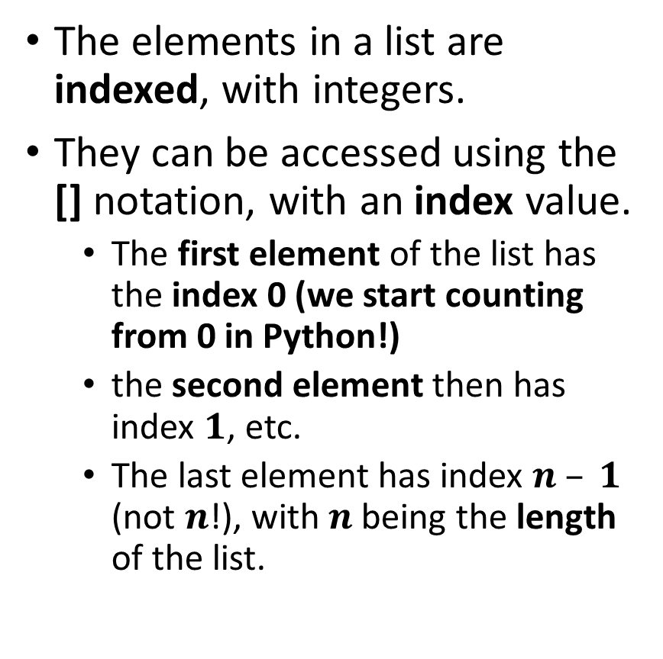
Indexing/Accessing the elements of a list
The elements in a list are indexed, with integers.
They can be accessed using the [] notation, with an index value.
The first element of the list has the index 0 (we start counting from 0 in Python!)
the second element then has index $1$, etc.
The last element has index $n – 1$ (not $n$!), with $n$ being the length of the list.

Slide 7
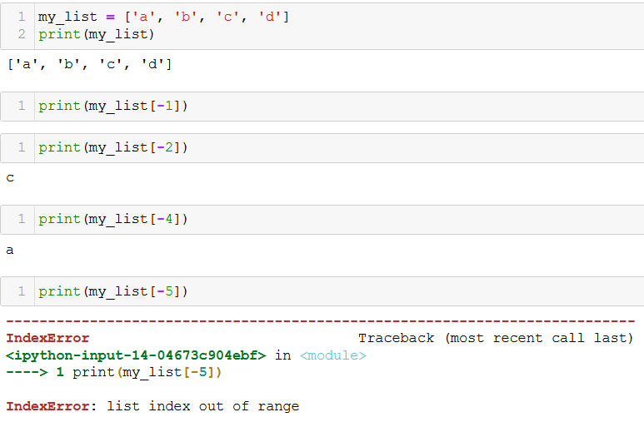
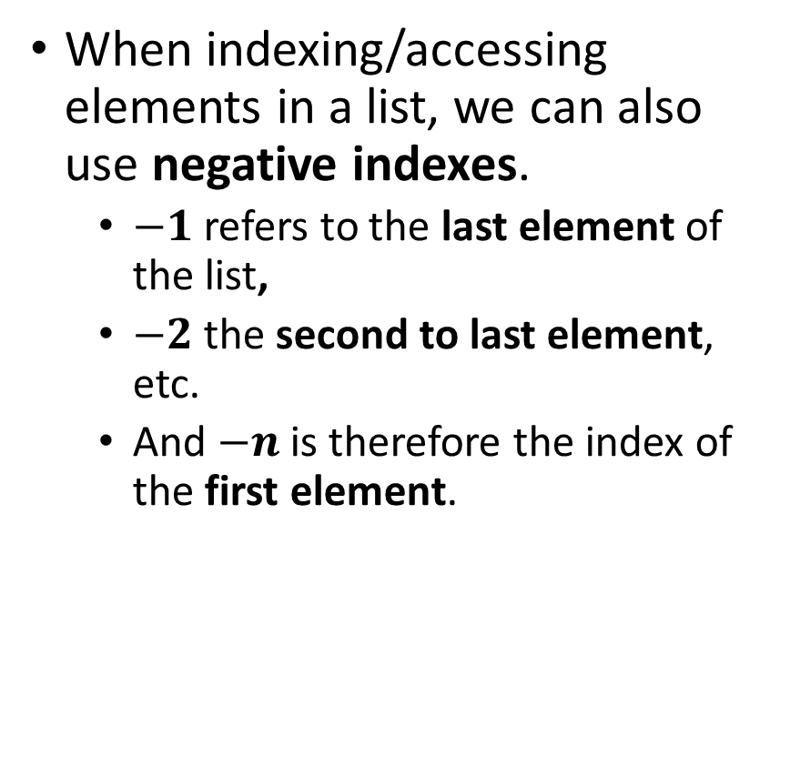
Indexing/Accessing the elements of a list
When indexing/accessing elements in a list, we can also use negative indexes.
$−1$refers to the last element of the list,
$−2$the second to last element, etc.
And $−n$is therefore the index of the first element.

Slide 8
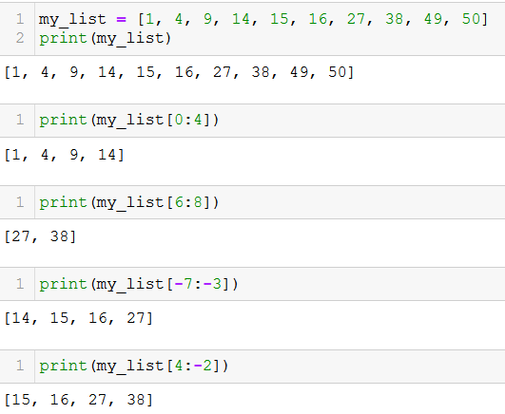
Slicing a list
You can retrieve a subset of the list, by specifying to indexes, separated with a colon (:) symbol.

Slide 9
Slicing a list
You can retrieve a subset of the list, by specifying to indexes, separated with a colon (:) symbol.
Indexing with [a:b] returns another list as a result, containing all elements of the original list:
Starting from index a (with a included),
All the way to index b (with b not included).

Slide 10
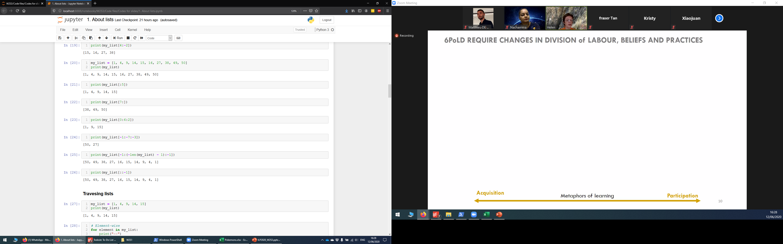
Slicing a list
Omitting a value in [a:b], either a or b, means “take all”.

Slide 11
Slicing a list
Omitting a value in [a:b], either a or b, means “take all”.
[:b] means:
all elements from the beginning of the list,
until index b (with b not included).

Slide 12
Slicing a list
Omitting a value in [a:b], either a or b, means “take all”.
[:b] means:
all elements from the beginning of the list,
until index b (with b not included).
[a:] means:
all element starting from index a,
until the end of the list (last element included).

Slide 13
Slicing a list
Indexing with [a:b:c] returns another list as a result, containing all elements of the original list:
Starting from index a (with a included),
All the way to index b (with b not included),
With steps of size c.

Slide 14
Slicing a list
Indexing with [a:b:c] returns another list as a result, containing all elements of the original list:
Starting from index a (with a included),
All the way to index b (with b not included),
With steps of size c.
Question: Which one of the statements below allows to display all the elements of a list my_list, in reverse order?
print(my_list[-1:-len(my_list)])
print(my_list[-len(my_list):-1])
print(my_list[-1:(-len(my_list)):-1])
print(my_list[-1:(-len(my_list)-1):-1])

Slide 15
Slicing a list
Indexing with [a:b:c] returns another list as a result, containing all elements of the original list:
Starting from index a (with a included),
All the way to index b (with b not included),
With steps of size c.
Question: Which one of the statements below allows to display all the elements of a list my_list, in reverse order?
print(my_list[-1:-len(my_list)])
print(my_list[-len(my_list):-1])
print(my_list[-1:(-len(my_list)):-1])
print(my_list[-1:(-len(my_list)-1):-1])

Slide 16
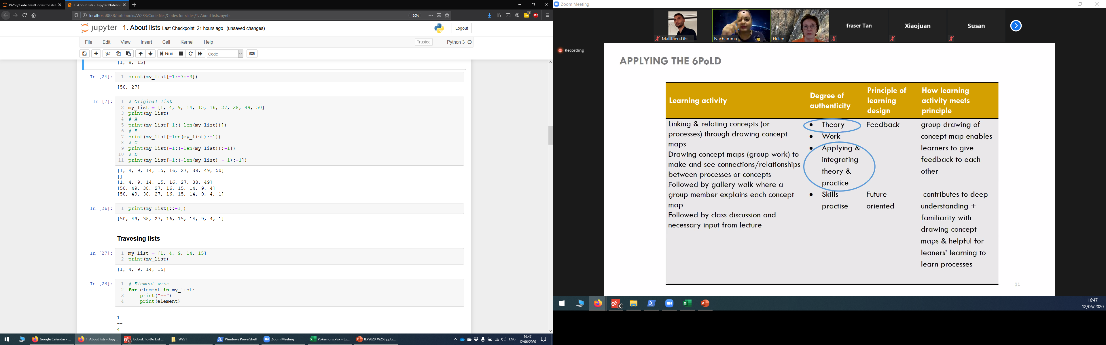
Slicing a list

Slide 17
Slicing a list

Slide 18
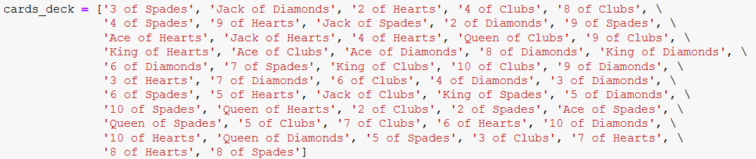
Activity 1 - Distributing a deck of cards
Let us consider a standard, shuffled deck of cards, defined as a list.
In this activity, we will distribute the cards between several players.

Slide 19
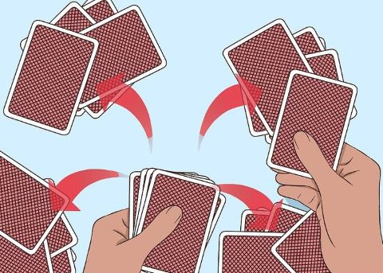
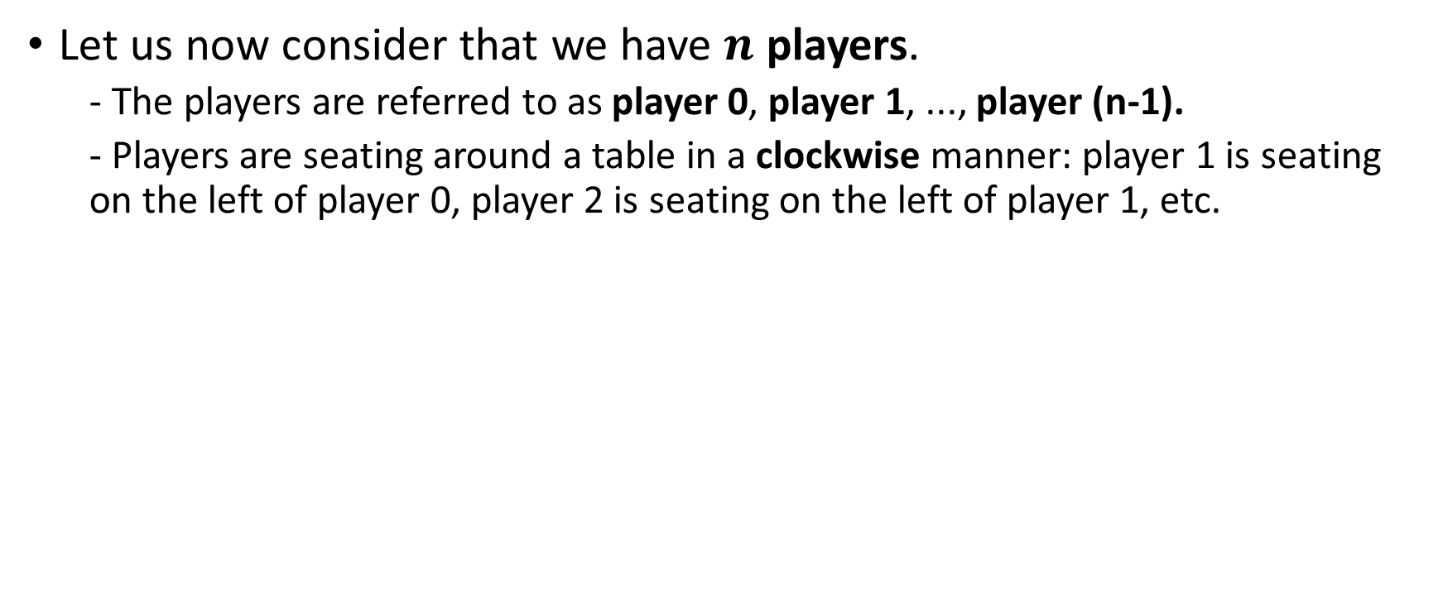
Activity 1 - Distributing a deck of cards
Let us now consider that we have $n$ players.
- The players are referred to as player 0, player 1, ..., player (n-1).
- Players are seating around a table in a clockwise manner: player 1 is seating on the left of player 0, player 2 is seating on the left of player 1, etc.
1
2
0
3

Slide 20
Activity 1 - Distributing a deck of cards
Write a function distribute_cards(), which
- receives a shuffled deck of cards, cards_deck, as its first input parameter,
- receives a number of players seating at the table, players_number, as its second input parameter,
- receives an integer player_index, with value in [0, players_number - 1], as its third input parameter. This corresponds to the position in which you are sitting at the table.
- receives an integer start_from, with value in [0, players_number - 1], as its fourth input parameter. This value corresponds to the first player to receive a card.

Slide 21
Activity 1 - Distributing a deck of cards
The function distribute_cards() then
- distributes all cards in the deck, one card at a time, in clockwise order, between all players,
- starting from the player with index start_from.
- It is ok if some players have one more card than other players (for instance, if the number of cards is not divisible by number of players)
The function distribute_cards() returns a list of cards, player_hand, corresponding to the hand of player sitting in position player_index, after we are done distributing the cards.
Find a smart slicing for the deck!

Slide 22
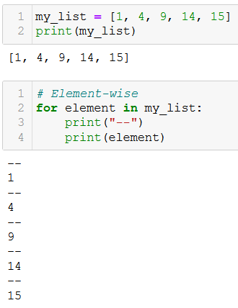
Traversing lists (element-wise)
You have seen how we can give lists to for statements to traverse and retrieve each element one-by-one.
The “for element in list:” approach is commonly referred to as traversing a list element-wise.

Slide 23
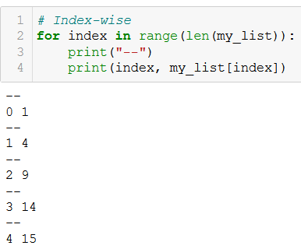
Traversing lists (index-wise)
You have seen how we can give lists to for statements to traverse and retrieve each element one-by-one.
The “for index in range(len(list)):” approach is commonly referred to as traversing a list index-wise.

Slide 24
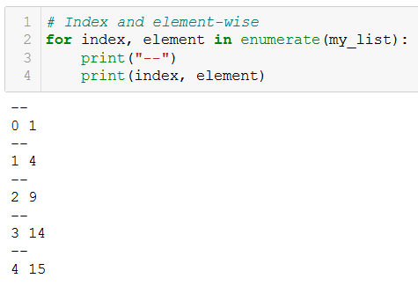
Traversing lists (index and element-wise)
You have seen how we can give lists to for statements to traverse and retrieve each element one-by-one.
You have also seen how to use the enumerate() generator, and how it allows to retrieve both the indexes and elements at the same time, while traversing a list.

Slide 25
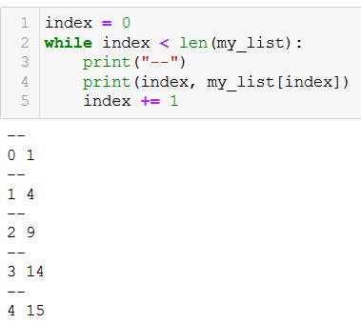
Traversing lists (while)
You have seen how we can give lists to for statements to traverse and retrieve each element one-by-one.
You can also replace the for loop with a while loop. (Not recommended however!)

Slide 26

Updating an element in a list
The indexing notation (list[index]) can be used to update an element in the list.
The accessed element receives (with the = sign symbol) a new value.
A list element is just another variable after all.

Slide 27
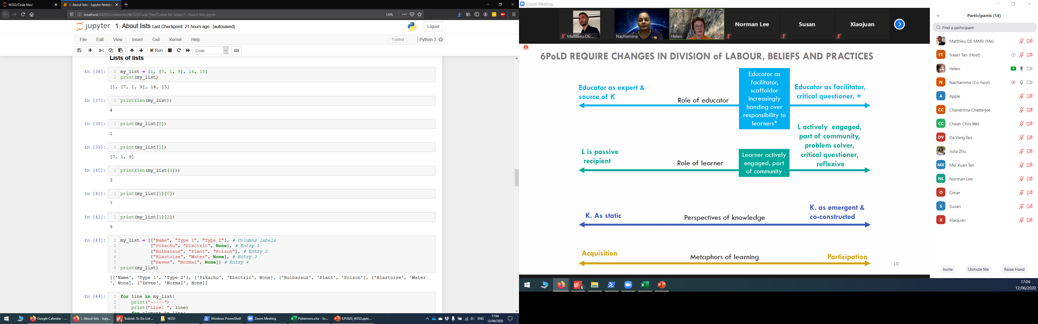
Lists of lists
Observation: an element of a list can be another list!
Careful with the len() function!
If an element of a list is a list itself, it still only counts as 1 element!

Slide 28
Lists of lists
Observation: an element of a list can be another list!
Careful with the len() function!
If an element of a list is a list itself, it still only counts as 1 element!
You can use multiple indexing, i.e. using [] several times in a row, to access the elements of a sublist.

Slide 29
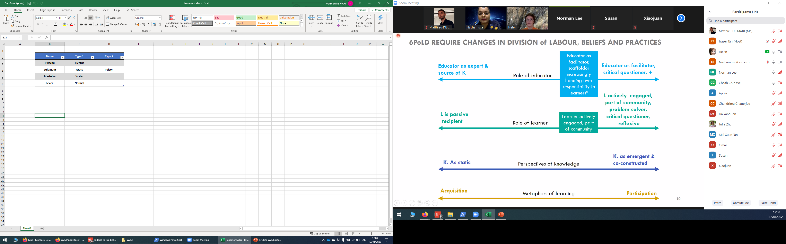
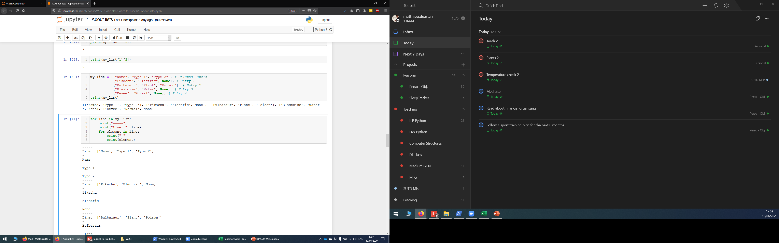
Lists of lists
Lists of lists are commonly used in Python to represent tables of values.
Widely used in Data Science!

Slide 30
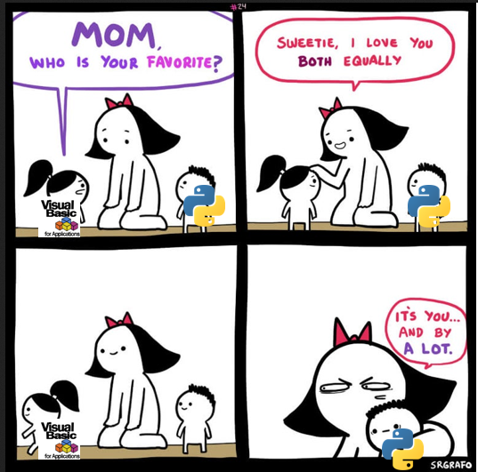


Lists of lists
Lists of lists are commonly used in Python to represent tables of values.
Widely used in Data Science!
Great news: this means that you will no longer need Excel!

Slide 31
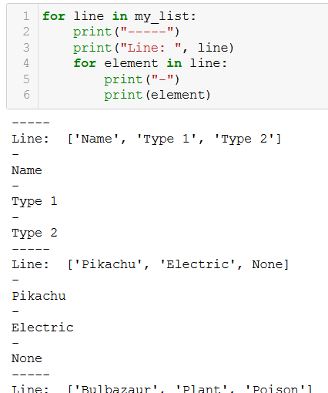
Lists of lists
Traversing lists of lists requires nested for loops.
The first for loop browses through the lines, which are the sublists of the list, one line at a time.

Slide 32
Lists of lists
Traversing lists of lists requires nested for loops.
The first for loop browses through the lines, which are the sublists of the list, one line at a time.
The second for loop browses through the elements in the sublists, one element at a time.

Slide 33
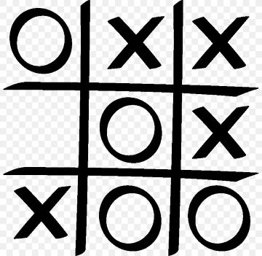
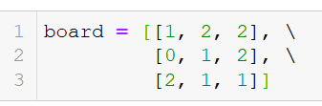
Activity 2 - TicTacToe
A tic tac toe board can be represented as a list of lists, by
defining a list of three elements,
each element is a sublist of three elements corresponding to each line, from up to down,
each sublist contains three elements, corresponding to each position on the line, from left to right,
element will have a value 0 if the position is empty,
element will have a value 1 if the position contains a circle,
element will have a value 2 if the position contains a cross,

Slide 34
Activity 2 - TicTacToe
A tic tac toe board can be represented as a list of lists.
Write a function board_winner(), which:
receives a board, defined as a list of lists, as its sole input parameter,
returns a single output, which consists of the value
1 if the circles won,
2 if the crosses won,
and 0 if there is no clear winner.

Slide 35
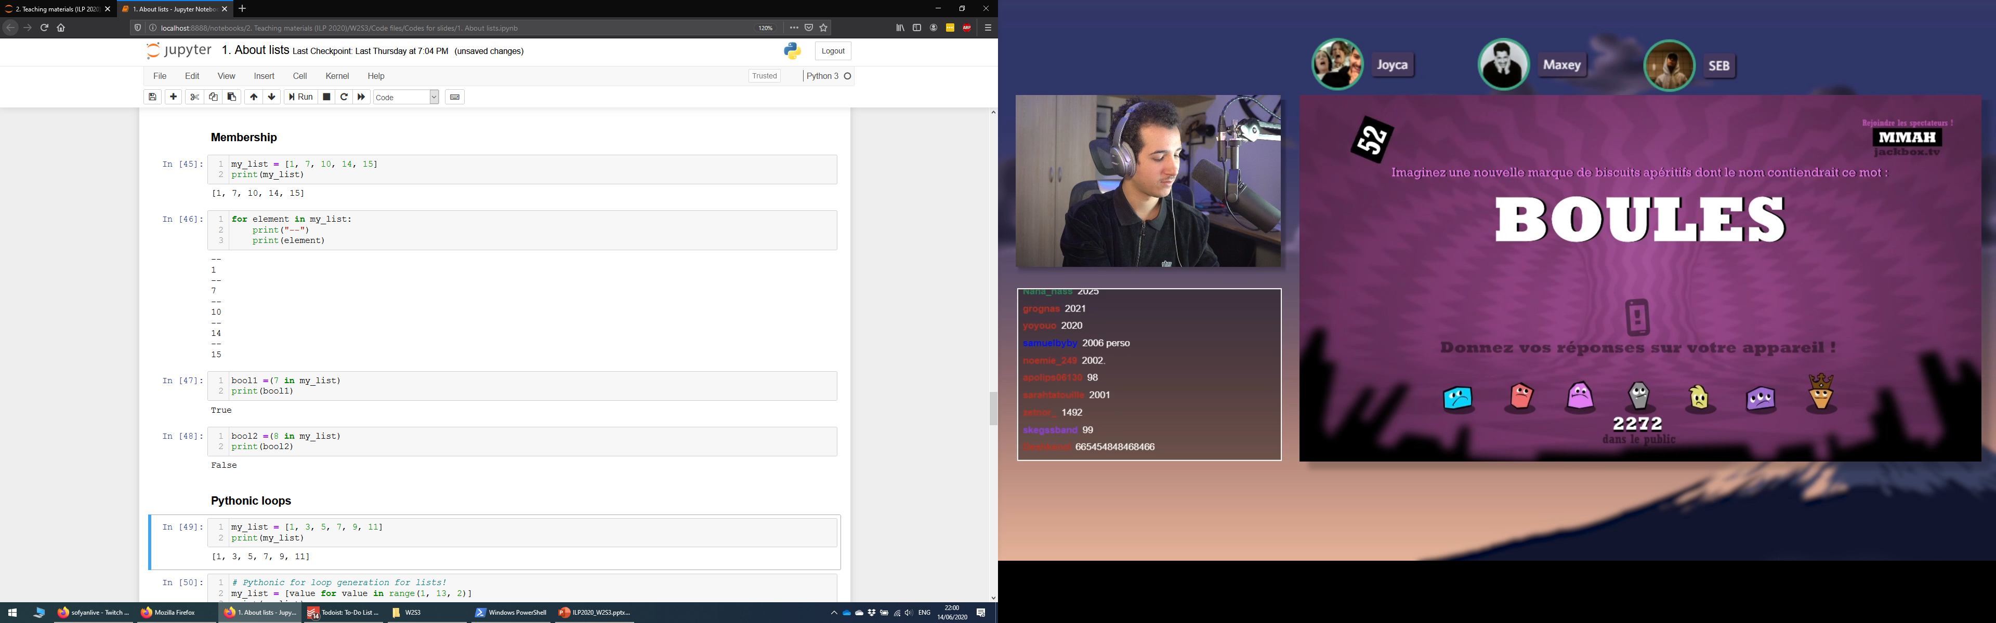
Membership: the in keyword
We have seen: the in keyword can be used to traverse lists in for loops.

Slide 36
Membership: the in keyword
We have seen: the in keyword can be used to traverse lists in for loops.
The in keyword can also be used to check for membership.
If the element appears in the list, then the result of the operation is a boolean True.
And False otherwise.

Slide 37
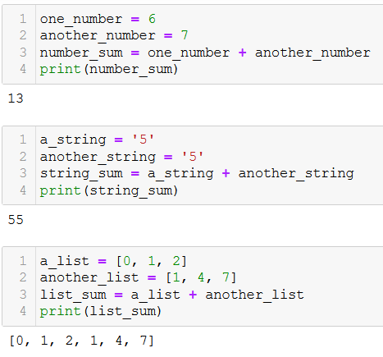
Concatenation: + operator overload for lists
Concatenation: you can merge two lists together, by using the + operator.

Slide 38
Concatenation: + operator overload for lists
Concatenation: you can merge two lists together, by using the + operator.
When summing two lists with +, Python does not sum the elements, as with numbers.
Instead, it behaves as with strings, and concatenates both.

Slide 39
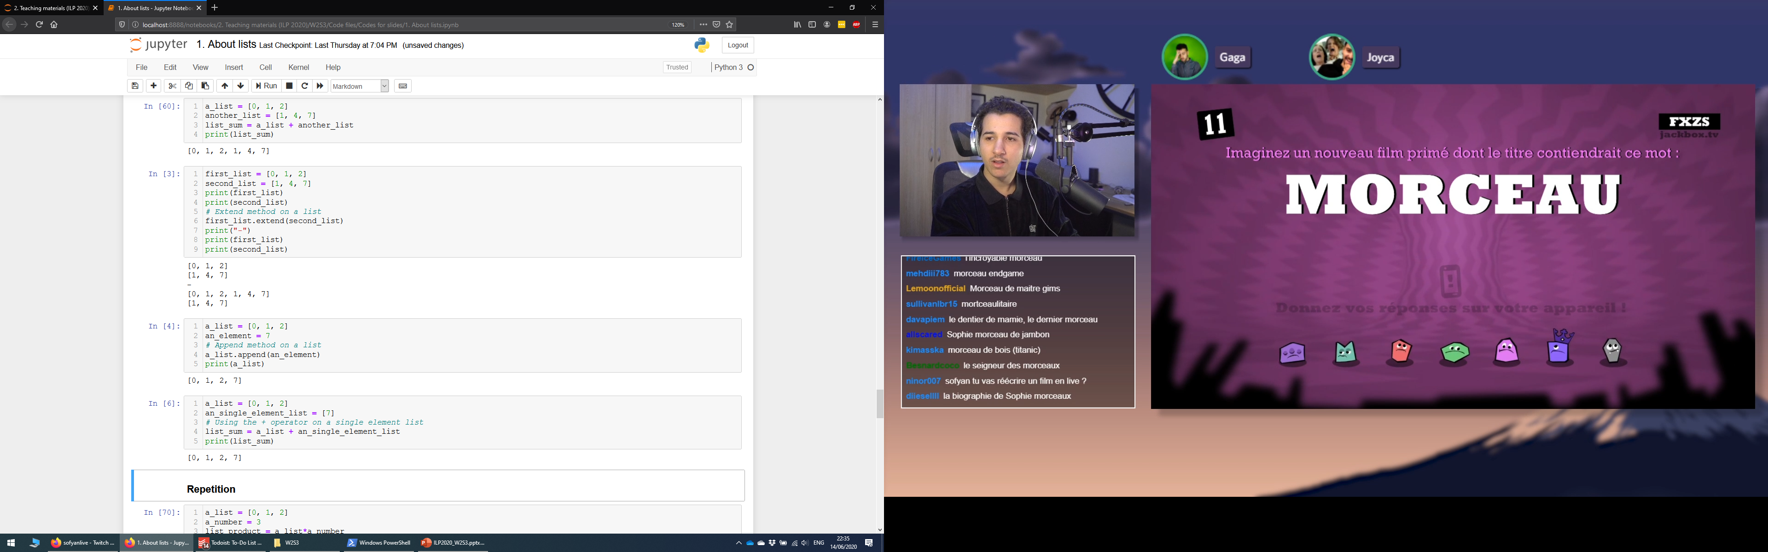
Adding an element with the append() method
Adding an element: you can add an element to a list with the append() method.
As with the extend() method, the append() method modifies the list on which the method is applied.

Slide 40
Adding an element with the append() method
Adding an element: you can add an element to a list with the append() method.
As with the extend() method, the append() method modifies the list on which the method is applied.
Adding an element #2: You can also use the + operator, with a single element list.

Slide 41
Activity 3 – Complete, sorted deck of cards
A standard deck of cards consists of all 52 possible combinations of 4 possible suits and 13 possible values.
The 4 possible suits are listed in the suits_list below.
suits_list = ["Hearts", "Diamonds", "Spades", "Clubs"]
The 13 possible values are listed in the values_list below.
values_list = ["Ace", "2", "3", "4", "5", "6", "7", "8", "9", "10", "Jack", "Queen", "King"]

Slide 42
Activity 3 – Complete, sorted deck of cards
Write a function complete_deck(),
which receives suits_list and values_list, as input parameters,
suits_list = ["Hearts", "Diamonds", "Spades", "Clubs"]
values_list = ["Ace", "2", "3", "4", "5", "6", "7", "8", "9", "10", "Jack", "Queen", "King"]
And returns a standard, sorted deck, as defined on the right.
deck = ['Ace of Hearts', '2 of Hearts', '3 of Hearts', '4 of Hearts’, …, 'Queen of Hearts', 'King of Hearts', 'Ace of Diamonds', '2 of Diamonds', '3 of Diamonds', '4 of Diamonds’, …, 'Queen of Diamonds', 'King of Diamonds', 'Ace of Spades', '2 of Spades', '3 of Spades', '4 of Spades’, …, 'Queen of Spades', 'King of Spades', 'Ace of Clubs', '2 of Clubs', '3 of Clubs', '4 of Clubs’, … 'Queen of Clubs', 'King of Clubs']

Slide 43
Activity 4 - Party merger
In many video games, you might form a group of friends and play together. In this activity, we will define a function, which attempts to merge two groups of players into a single one.
A group will simply consist of a list of names, as shown below.
group = ["Matt", "Oka", "Tony", "Norman"]
Write a function merge_groups(), which receives two groups of people as lists of names.
We will call these two groups variables, group1 and group2 respectively.
This function will merge both groups into a new one containing the members of both groups, and will return the merged_group list as its only output.
However, it will only do so, if the resulting merged group does not contain more than 6 people. Otherwise, the function will return both group1 and group2, therefore refusing to merge them.

Slide 44
More methods and functions on lists
The lists objects in Python have many more built-in methods and functions you could use.
We do not expect you to know about all these methods and functions, nor about how they work in detail.
Just know where to find the information if you need it.
Also, do not be afraid to read the Python documentation!
List documentation: https://docs.python.org/3/tutorial/datastructures.html

Slide 45
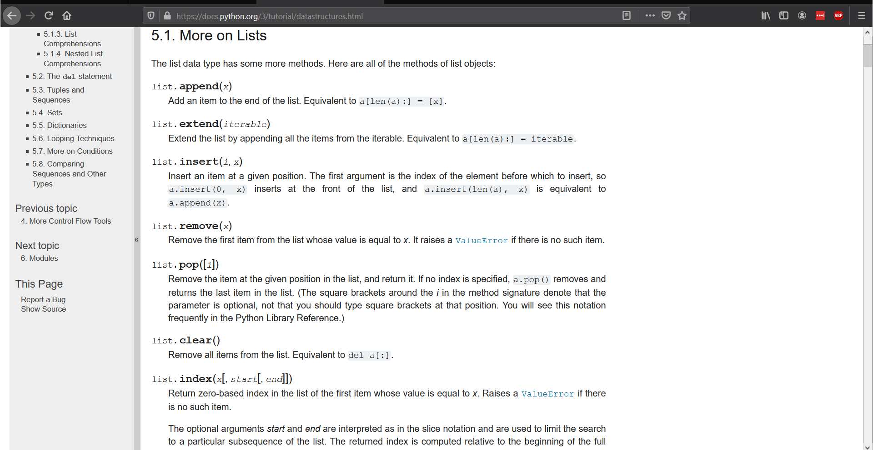
More methods and functions on lists

Slide 46
RTFM
Definition (RTFM): The acronym RTFM stands for

Slide 47
RTFM
Definition (RTFM): The acronym RTFM stands for “Read.

Slide 48
RTFM
Definition (RTFM): The acronym RTFM stands for “Read. The.

Slide 49
RTFM
Definition (RTFM): The acronym RTFM stands for “Read. The. F***ing.

Slide 50
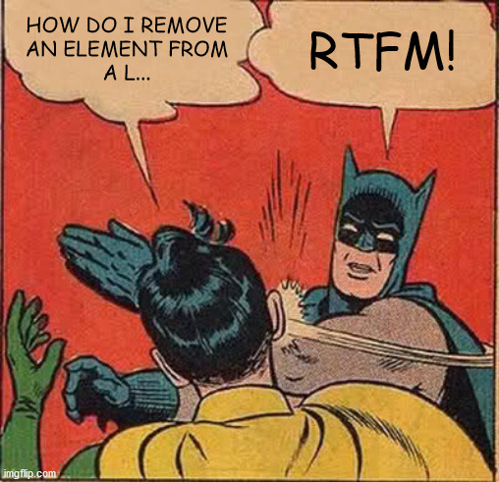

RTFM
Definition (RTFM): The acronym RTFM stands for “Read. The. F***ing. Manual.”.

Slide 51
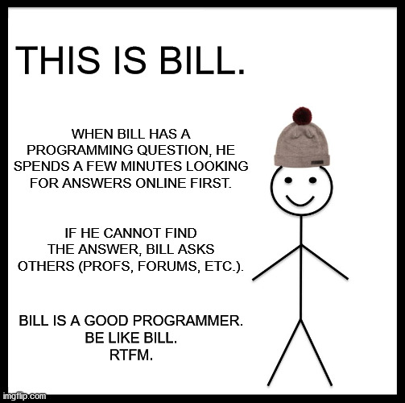
RTFM
Definition (RTFM): The acronym RTFM stands for “Read. The. F***ing. Manual.”.
While it may sound rude, RTFM is positively used in computer science communities, to encourage people to try to help themselves first, before seeking assistance from others.

Slide 52

Matt’s Great advice #9
Matt’s Great Advice #9: Do not fear the Python documentation.
No programmer in the world knows everything about every function, method and variable type in Python.
Instead, we know where and how to find the information online, when needed.
Make it a habit to look for the Python documentation when in doubt or looking for something specific!

Slide 53
Conclusion
The list type (in detail)
Length of a list
Indexing, slicing, updating and traversing a list
Lists of lists
Membership
Concatenation, repetition and insertion
Removing elements from a list
Advanced methods and RTFM!

Slide 54
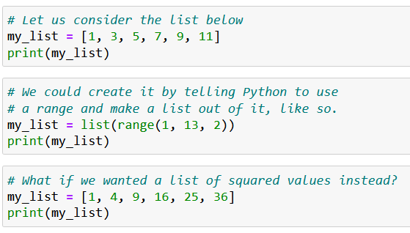
“Pythonic” loops
Definition (Pythonic loop): A Pythonic loop is a programming concept, where a list of elements is generated by integrating a for loop inside a list definition.

Slide 55
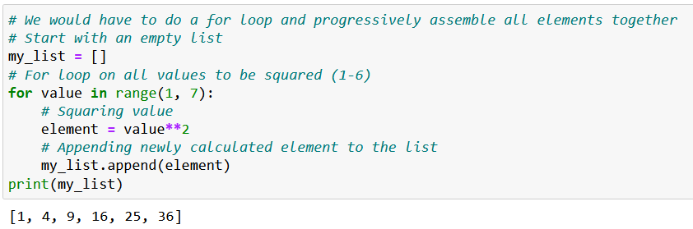
“Pythonic” loops
Definition (Pythonic loop): A Pythonic loop is a programming concept, where a list of elements is generated by integrating a for loop inside a list definition.

Slide 56
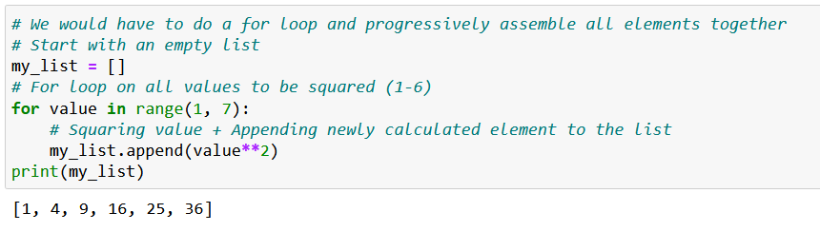
“Pythonic” loops
Definition (Pythonic loop): A Pythonic loop is a programming concept, where a list of elements is generated by integrating a for loop inside a list definition.

Slide 57
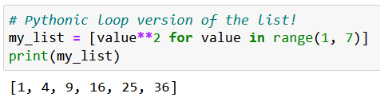
“Pythonic” loops
Definition (Pythonic loop): A Pythonic loop is a programming concept, where a list of elements is generated by integrating a for loop inside a list definition.

Slide 58
“Pythonic” loops
Definition (Pythonic loop): A Pythonic loop is a programming concept, where a list of elements is generated by integrating a for loop inside a list definition.

Slide 59
“Pythonic” loops
Definition (Pythonic loop): A Pythonic loop is a programming concept, where a list of elements is generated by integrating a for loop inside a list definition.

Slide 60
“Pythonic” loops
Definition (Pythonic loop): A Pythonic loop is a programming concept, where a list of elements is generated by integrating a for loop inside a list definition.

Slide 61
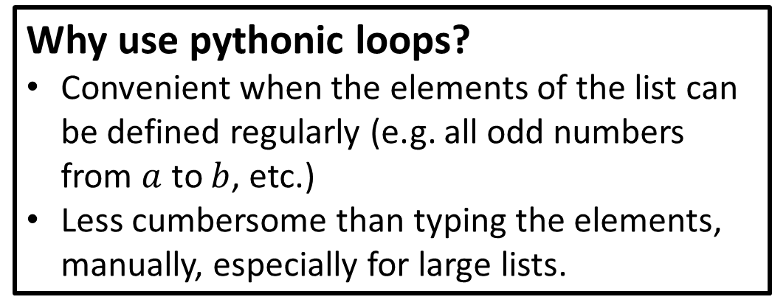
“Pythonic” loops
Definition (Pythonic loop): A Pythonic loop is a programming concept, where a list of elements is generated by integrating a for loop inside a list definition.
Why use pythonic loops?
Convenient when the elements of the list can be defined regularly (e.g. all odd numbers from $a$ to $b$, etc.)
Less cumbersome than typing the elements, manually, especially for large lists.

Slide 62
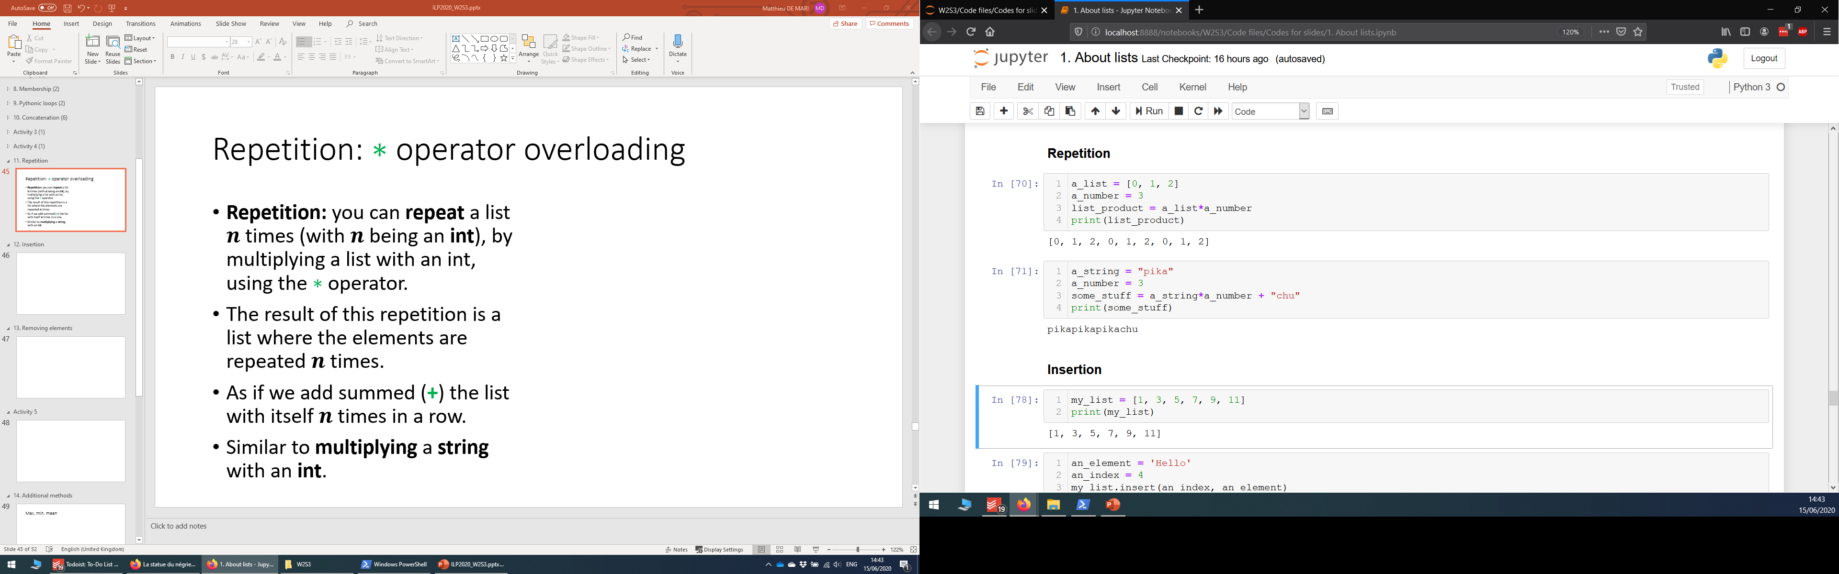
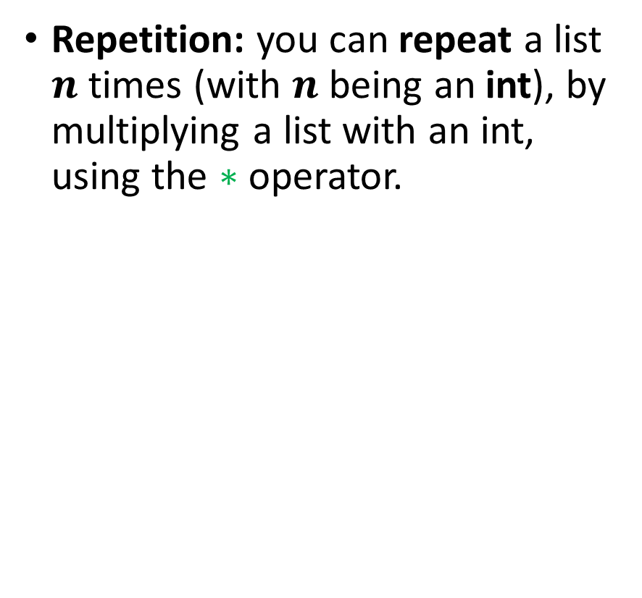

Repetition: $∗$ operator overloading
Repetition: you can repeat a list $n$ times (with $n$ being an int), by multiplying a list with an int, using the $∗$ operator.

Slide 63
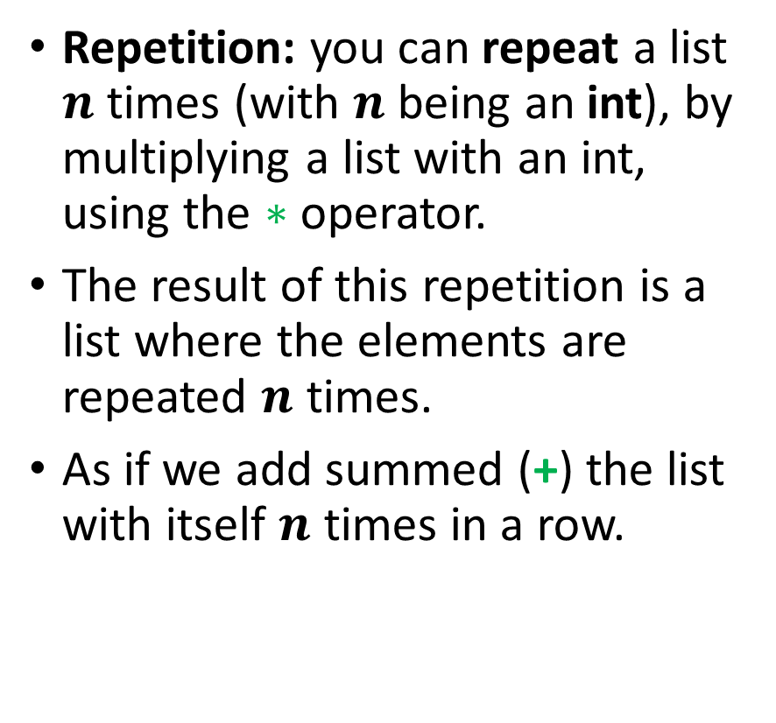
Repetition: $∗$ operator overloading
Repetition: you can repeat a list $n$ times (with $n$ being an int), by multiplying a list with an int, using the $∗$ operator.
The result of this repetition is a list where the elements are repeated $n$ times.
As if we add summed (+) the list with itself $n$ times in a row.

Slide 64
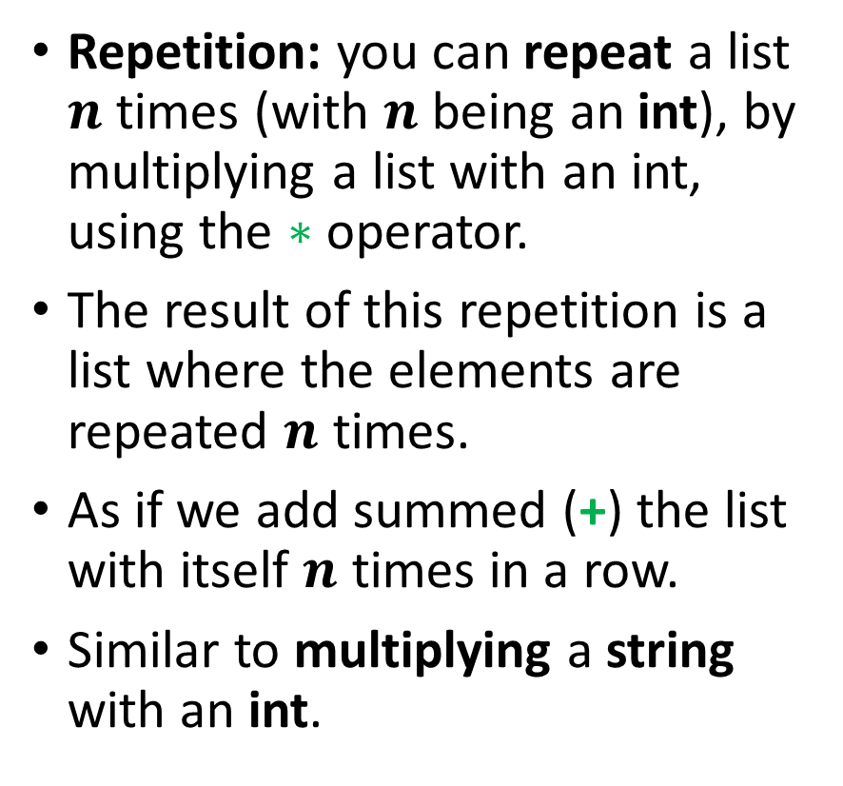
Repetition: $∗$ operator overloading
Repetition: you can repeat a list $n$ times (with $n$ being an int), by multiplying a list with an int, using the $∗$ operator.
The result of this repetition is a list where the elements are repeated $n$ times.
As if we add summed (+) the list with itself $n$ times in a row.
Similar to multiplying a string with an int.

Slide 65
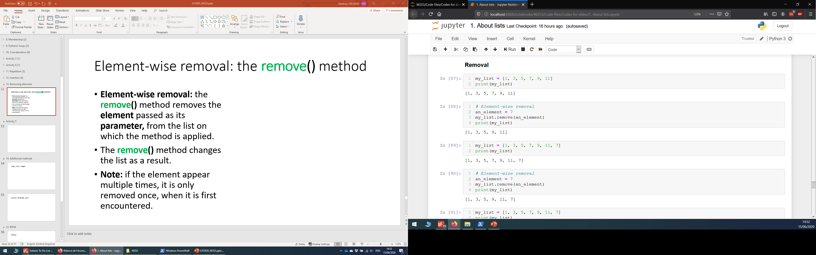
Element-wise removal
Element-wise removal: the remove() method removes the element passed as its parameter, from the list on which the method is applied.

Slide 66
Element-wise removal
Element-wise removal: the remove() method removes the element passed as its parameter, from the list on which the method is applied.
The remove() method changes the list as a result.

Slide 67
Element-wise removal
Element-wise removal: the remove() method removes the element passed as its parameter, from the list on which the method is applied.
The remove() method changes the list as a result.
Note: if the element appear multiple times, it is only removed once, when it is first encountered.

Slide 68
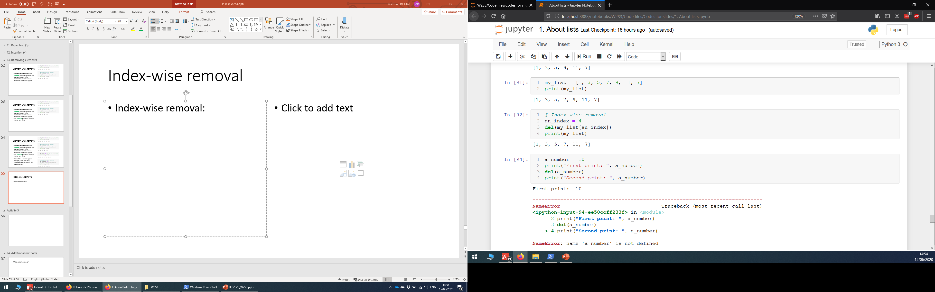
Index-wise removal
Index-wise removal: you can remove an element at a given index by using the del function on the element itself.

Slide 69
Index-wise removal
Index-wise removal: you can remove an element at a given index by using the del function on the element itself.
Note: the del function can be used on any variable, of any type, to remove it from the Python memory.

Slide 70
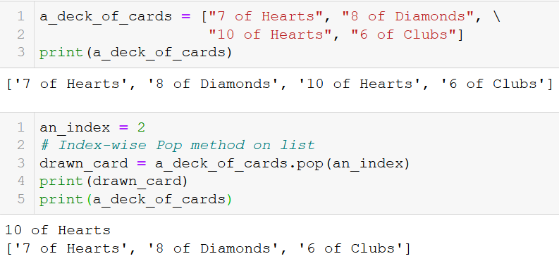
Index-wise extraction
Index-wise extraction: you can extract the element of a list, at the index given as its parameter, by using the pop() method.

Slide 71
Index-wise extraction
Index-wise extraction: you can extract the element of a list, at the index given as its parameter, by using the pop() method.
As with other methods, it changes the list on which it is applied.

Slide 72
Index-wise extraction
Index-wise extraction: you can extract the element of a list, at the index given as its parameter, by using the pop() method.
As with other methods, it changes the list on which it is applied.
The output of the pop() method consists of the element, which is extracted from the list, at the given index.

Slide 73
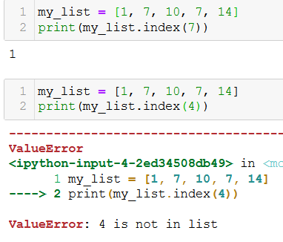
The index() method
The index() method is also useful to check for membership and find an element in a list.
It returns the index of the first occurrence of the element passed in parameter, in the list it applies to.
Careful though, as it fails if no element in the list has the value passed as parameter.

Slide 74
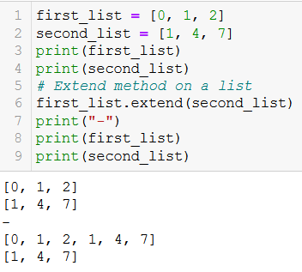
List alteration with the extend() method
Concatenation: A second list can be added to a first one with the extend() method.

Slide 75
List alteration with the extend() method
Concatenation: A second list can be added to a first one with the extend() method.
This is slightly different, as
It changes the list on which the extend() method is applied,
And adds the elements of the second lists to the first one.
At the end of the operation, the first list will be changed.

Slide 76
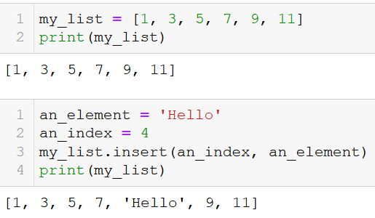
Inserting an element in a list
Insertion: You can insert an element, at a given index, by using the insert() method.
As with the extend() and append() methods, the insert() method is applied to a list.
It receives an index as its first parameter and an element as its second parameter.
And it changes the list as a result.

Slide 77
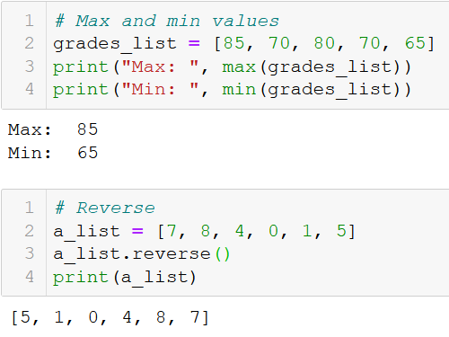
Additional methods and functions on lists
Many other additional methods and functions can be used on lists objects…
Maximum: the max() function returns the element with maximal value.
Minimum: the min() function returns the element with maximal value.
Reverse: the reverse() method reverses the elements in a list.

Slide 78
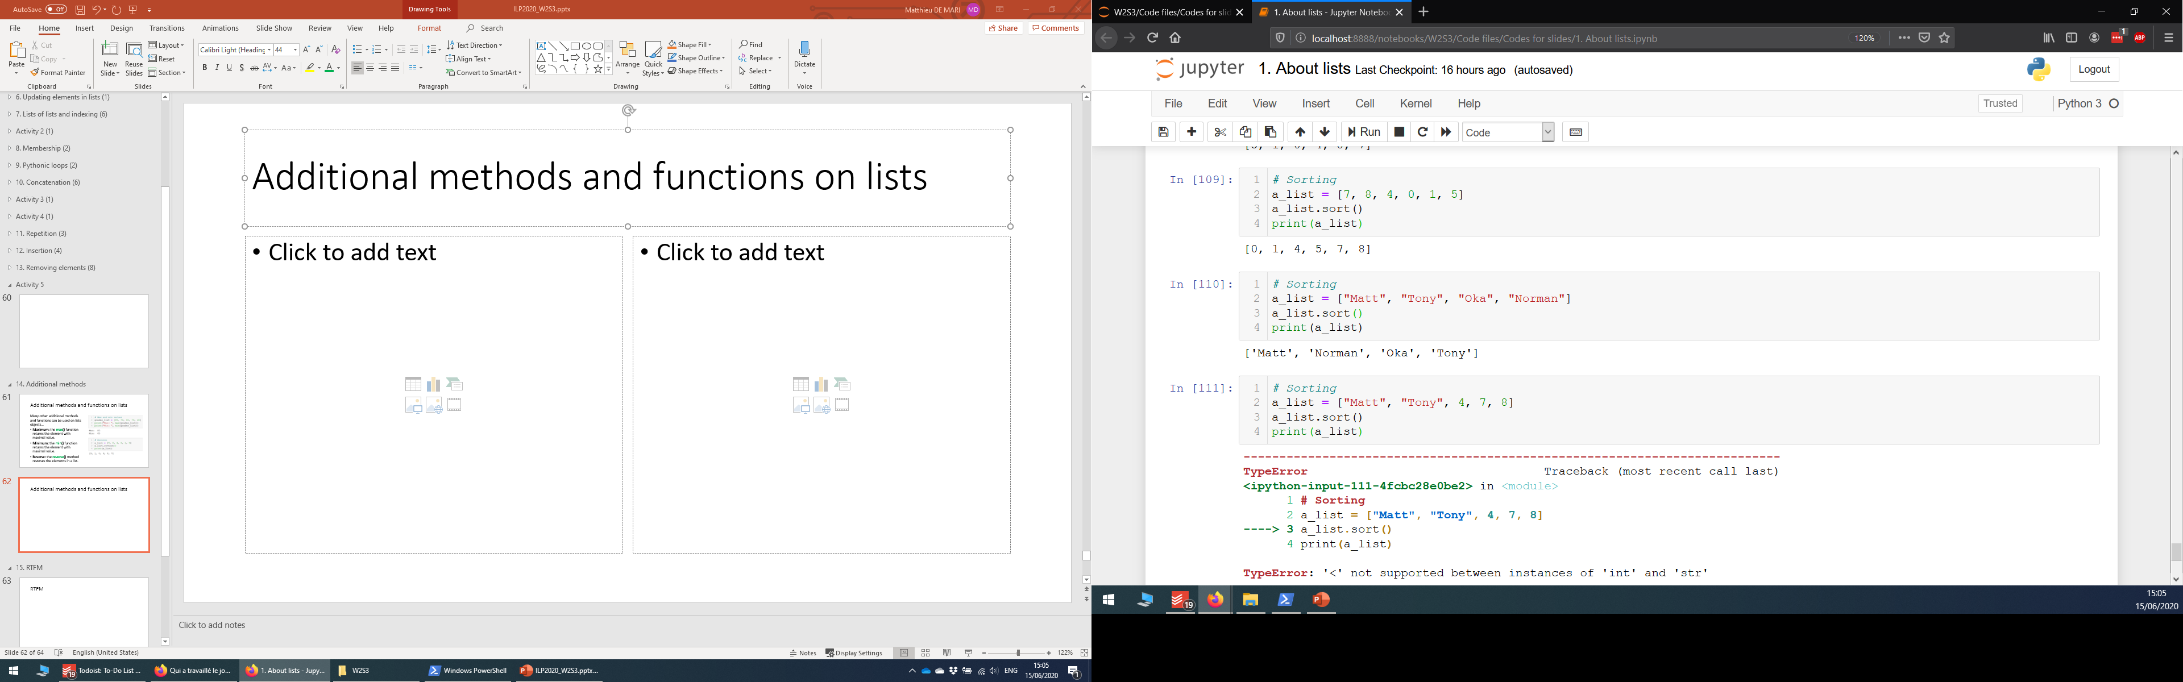
Additional methods and functions on lists
Many other additional methods and functions can be used on lists objects…
Sorting: the sort() method can be used to sort the elements,

Slide 79
Additional methods and functions on lists
Many other additional methods and functions can be used on lists objects…
Sorting: the sort() method can be used to sort the elements,
In ascending order for numerical elements,

Slide 80
Additional methods and functions on lists
Many other additional methods and functions can be used on lists objects…
Sorting: the sort() method can be used to sort the elements,
In ascending order for numerical elements,
And in alphabetical order for string elements.

Slide 81
Additional methods and functions on lists
Many other additional methods and functions can be used on lists objects…
Sorting: the sort() method can be used to sort the elements,
In ascending order for numerical elements,
And in alphabetical order for string elements.
Note: does not work on lists with mixed types elements.

Slide 82
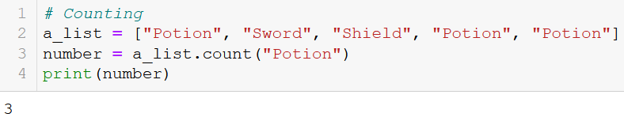
Additional methods and functions on lists
Many other additional methods and functions can be used on lists objects…
Counting: the count() method can be used to count how many times an element appears in a list.

